Slide 1
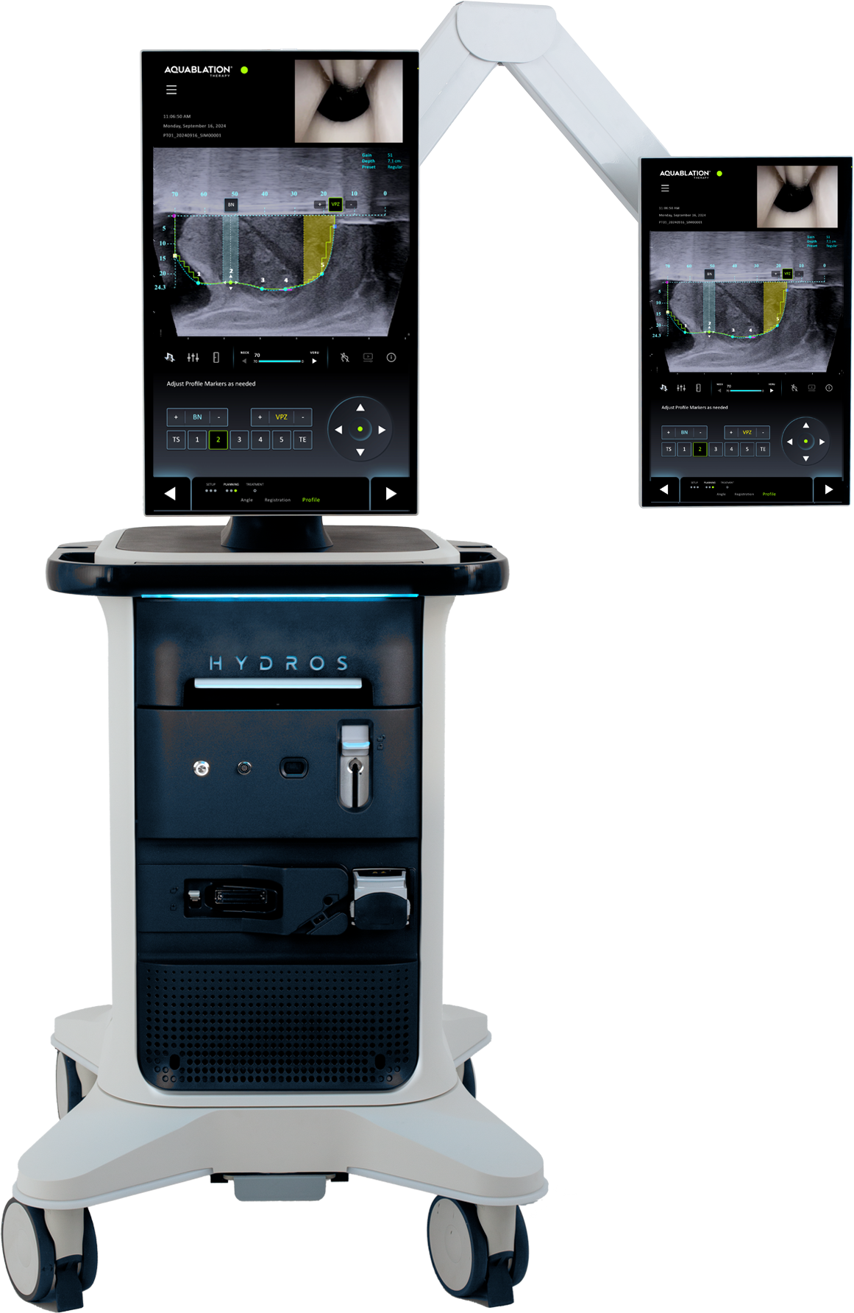
Elevating the Standard of Care for Benign Prostatic Hyperplasia (BPH) Treatment
Insert Hospital or Practice Logo

Slide 2
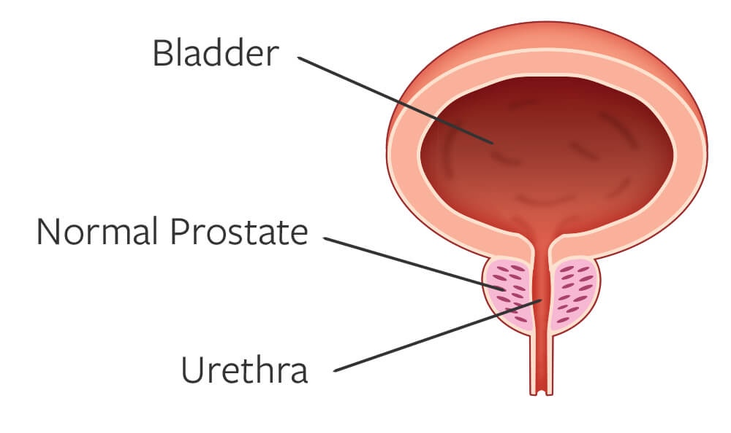
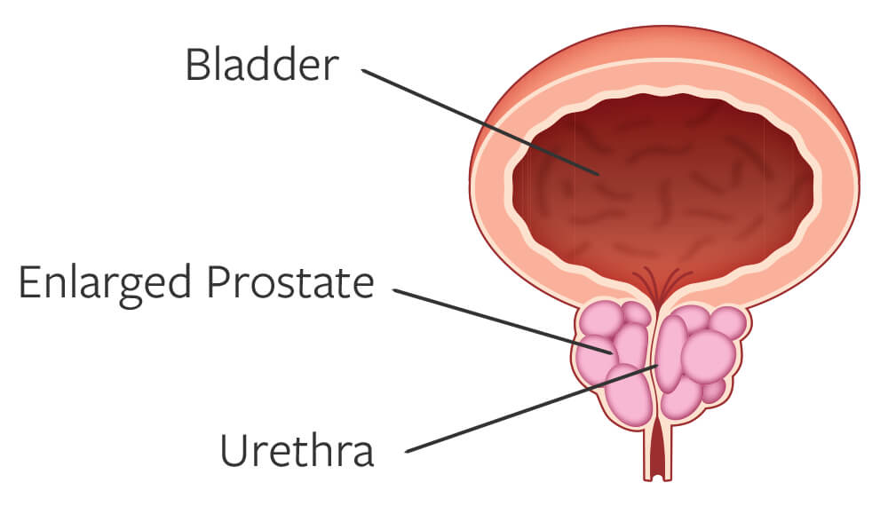
BPH is Prevalent and Expected to Increase
NORMAL PROSTATE
BPH is the #1 reason men visit the urologist
50% of men 51-60 years old have BPH
90% of men 80-90 years old suffer from BPH
ENLARGED PROSTATE (BPH)
~40M men in the US living with BPH in the US
Vuichoud C, Loughlin KR. Benign prostatic hyperplasia: epidemiology, economics and evaluation. Can J Urol. 2015;22(suppl1):1-6.
Notes:
https://www.ncbi.nlm.nih.gov/pmc/articles/PMC8170717/

Slide 3










Lower Urinary Tract Symptoms Due to BPH
1
2
99%
Men say BPH impacts their
quality of lifef²
ABILITY TO HOLD URINE
EMPTYING THE BLADDER
Nocturia: the need to urinate frequently while sleeping
Frequency: the need to urinate more often than normal
Urgency: the need to urinate immediately or urgently
Incontinence: complete loss of the ability to hold urine
Weak Stream: gentle instead of a strong stream of urine
Straining: the need to push to start or complete urinating
Hesitancy: difficulty starting to urinate
Intermittency: a urine stream that starts and stops
Retention: complete loss of the ability to empty the bladder
Disrupted Sleep, Limited Activities, Sexual Dysfunction

Slide 4


Many Men Go Untreated Due to Unwanted Side Effects
40M
MEN
In the US have BPH
12M+ US MEN actively managed
for BPH each year
6.7M
PHARMACEUTICALS/MEDICATIONS
Suffer dosing adjustments and side effects
1.1M
PHARMACEUTICAL FALLOUT
Delay surgery despite medication failure
400K
SURGERIES PER YEAR
May compromise between safety and efficacy outcomes
83%
OF MEN ARE NOT WILLING TO SACRIFICE SEXUAL FUNCTION FOR SYMPTOM RELIEF²
Vuichoud C, Loughlin KR. Benign prostatic hyperplasia: epidemiology, economics and evaluation. Can J Urol. 2015;22(suppl1):1-6.
Emberton M, Marberger M, de la Rosette J. Understanding patient and physician perceptions of benign prostatic hyperplasia in Europe: the Prostate Research on Behaviour and Education (PROBE) Survey. Int J Clin Pract. 2008;62(1):18-26. 3.
Kaplan SA. Factors in predicting failure with medical therapy for BPH. Rev Urol. 2005; 7(suppl 7):S34-S39.

Slide 5





AQUABLATION MINIMIZES THE COMPROMISE IN ALL PROSTATES
UROLOGISTS CAN TREAT MORE PATIENTS WITH A SINGLE MODALITY
Unmet Need: Safety & Efficacy
in Prostates of All Sizes and Shapes
PRIORITIZE
Sexual Function
and Continence Preservation
PRIORITIZE
Symptom
Relief
Symptom Relief
Sexual Function
and Continence Preservation
small
(30-40mL)
medium
(40-80mL)
large
(80-150mL)
extra large
(150mL+)
TURP & PVP
Enucleation & Simple
NON-RESECTIVE
MIST
RESECTIVE
PVP = Photovaporization of Prostate
MIST: Minimally Invasive Surgical Technology
BPH size ranges: AUA Guidelines: Management of Lower Urinary Tract Symptoms Attributed to Benign Prostatic Hyperplasia (BPH): AUA Guideline Amendment 2023
Tanneru et al: An Indirect Comparison of Newer Minimally Invasive Treatments for Benign Prostatic Hyperplasia: A Network Meta-Analysis Model, Journal of Endourology, 2020
Notes:
TALK TO SNEHA - is this the correct slide from what Sneha was working on
Move image up so disclaimers are separated

Slide 6

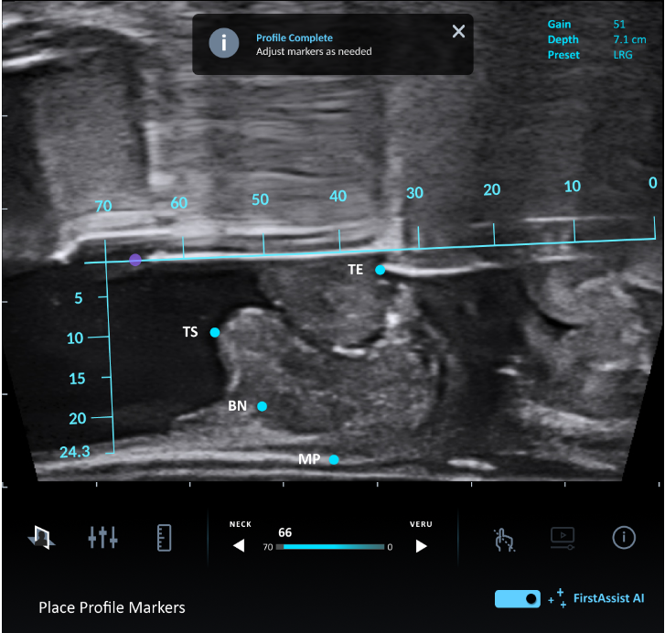
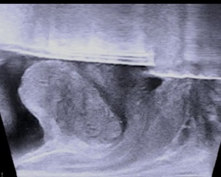
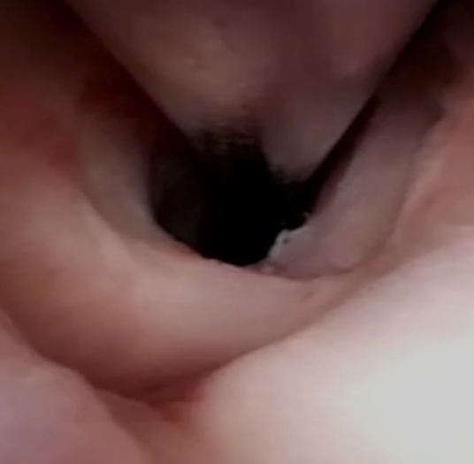
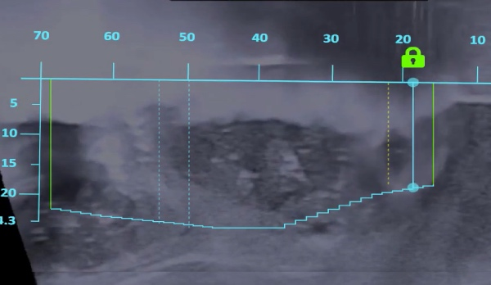
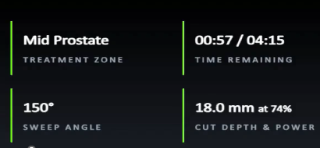
The HYDROS Robotic System is the next-generation, AI-powered platform for Aquablation therapy
AI-Powered
TREATMENT
Planning
ADVANCED
image guidance
Robotic
rESECTION
Streamlined
workflow
  FirstAssist AI™ aids urologists in identifying critical anatomy on ultrasound & suggesting an optimal treatment plan for each patient
  Real-time, intraoperative ultrasound & cystoscopic imaging provide a detailed view of the prostate & critical anatomy
  Robotic-assisted waterjet follows the treatment plan to resect obstructive tissue while protecting critical anatomy, enabling an efficient and predictable resection
  With a single footprint, the integrated tower facilitates efficient operating room setup and turnover
Notes:
HYDROS offers AI-Powered treatment planning, advanced image guidance, robotic resection and a streamlined workflow designed to improve efficiency, enhance surgeon and staff experience and deliver a more accurate and consistent treatment plan.

Slide 7




JOIN THE MOMENTUM
Aquablation therapy is backed by robust long-term clinical trial data…
5-year results
5-year results
1-year results
3-month results
Prostates 30 mL to 80 mL
Prostates 80 mL to 150 mL
Prostates 20 mL to 150 mL
Prostates 20 mL to 242 mL
Aquablation therapy has shown in clinical trials to deliver significant, durable symptom relief
while preserving sexual function & continence across prostates of all shapes and sizes¹⁻³
1. Gilling PJ, Barber N, Bidair M, et al. Five-year outcomes for Aquablation therapy compared to TURP: results from a double-blind, randomized trial in men with LUTS due to BPH. Can J Urol. 2022;29(1):10960-10968.
2. Bhojani N, Bidair M, Kramolowsky E, et al. Aquablation Therapy in Large Prostates (80-150 mL) for Lower Urinary Tract Symptoms Due to Benign Prostatic Hyperplasia: Final WATER II 5-Year Clinical Trial Results. J Urol. 2023;210(1):143-153.
3. PROCEPT data on file

Slide 8

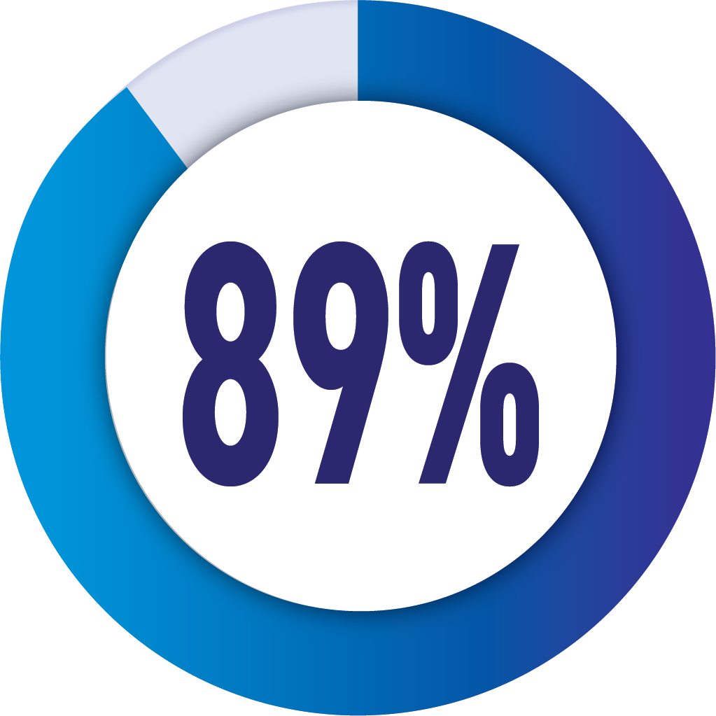
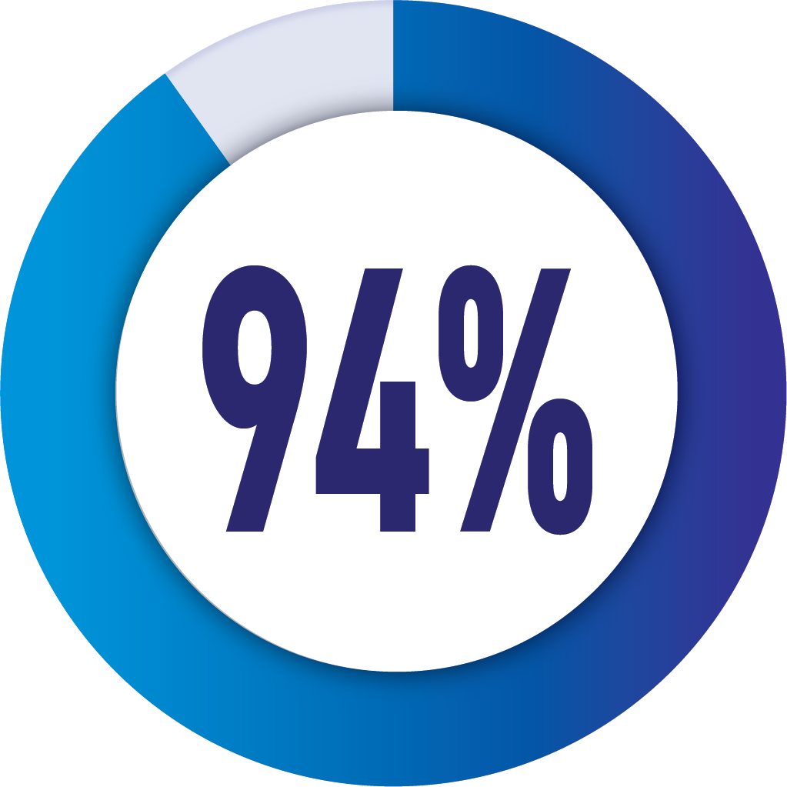
JOIN THE MOMENTUM
Aquablation therapy has shown in clinical trials to deliver significant, durable symptom relief
while preserving sexual function & continence across prostates of all shapes and sizes¹⁻²
SAFETY
EFFICACY
DURABILITY
Low irreversible complications preserving sexual function & continence³
Significant
symptom relief³
Low retreatment rates after 5 years in small, medium and large sized prostates¹⁻²
Of patients
preserved
ejaculatory function³
Effective in improving patient symptom scores from “Severe” to “Mild” as measured by IPSS³
of patients did not need another BPH intervention at 5 years
post-Aquablation therapy¹⁻²
IPSS = International Prostate Symptom Score
1. Gilling PJ, Barber N, Bidair M, et al. Five-year outcomes for Aquablation therapy compared to TURP: results from a double-blind, randomized trial in men with LUTS due to BPH. Can J Urol. 2022;29(1):10960-10968.
2. Bhojani N, Bidair M, Kramolowsky E, et al. Aquablation Therapy in Large Prostates (80-150 mL) for Lower Urinary Tract Symptoms Due to Benign Prostatic Hyperplasia: Final WATER II 5-Year Clinical Trial Results. J Urol. 2023;210(1):143-153. 3. Elterman D, Gilling P, Roehrborn C, et al. Meta-analysis with individual data of functional outcomes following Aquablation for lower urinary tract symptoms due to BPH in various prostate anatomies. BMJ Surg Interv Health Technologies 2021;3:e000090. doi:10.1136/bmjsit-2021-000090

Slide 9
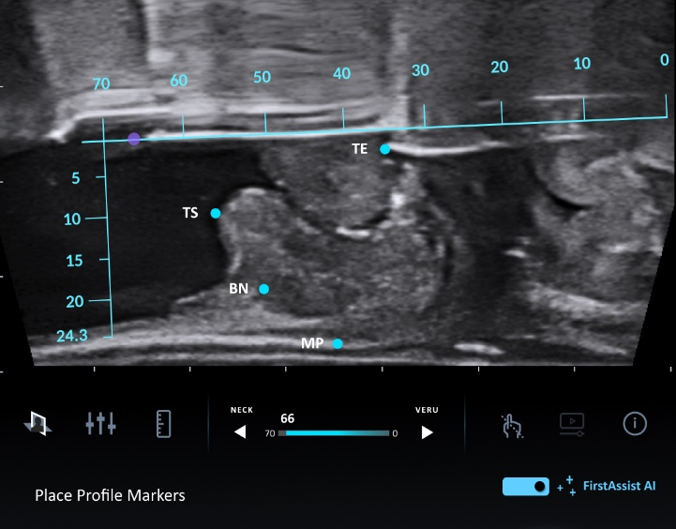
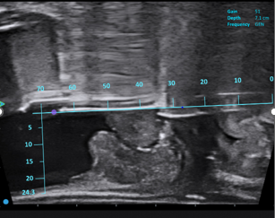
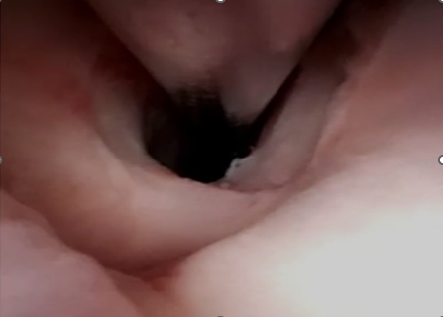

AI Powered Treatment Planning
INTEGRATES AI WITH ADVANCED IMAGE GUIDANCE FOR MORE ACCURACY AND CONSISTENCY
REAL-TIME ULTRASOUND & CYSTOSCOPY
AI-POWERED TREATMENT PLANNING
Provides full, detailed view of the anatomy
Customized intraoperative planning
FirstAssist AI™ developed with:
Real world Aquablation therapy procedures
Input from expert surgeons
Image recognition software
Aids surgeons in:
Identifying critical anatomy on ultrasound
Suggesting an optimal treatment plan unique to each patient
HELPS SURGEONS OPTIMIZE RESECTION WHILE PROTECTING CRITICAL ANATOMY

Slide 10
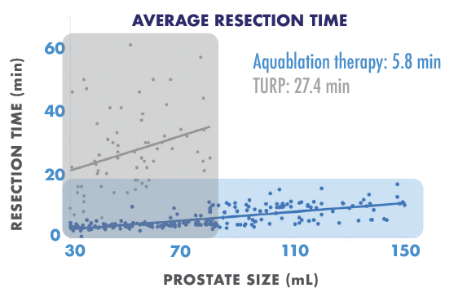
Predictable, Robotic-Assisted Heat-Free Waterjet Resection
LESS VARIABILITY IN RESECTION TIMES
Surgeons participating in trial were experienced TURP surgeons with no Aquablation experience
ROBOTIC-ASSISTED WATERJET
ENABLES CONSISTENT RESECTION TIMES
REGARDLESS OF PROSTATE SIZE & SURGEON EXPERIENCE
Data on file, PROCEPT BioRobotics
Notes:
Through robotic-automation, there is less variability in resection times, regardless of surgeon experience with Aquablation therapy

Slide 11
Aquablation Therapy Procedure Animation Video

Slide 12

What to Expect After Aquablation Therapy
As with most BPH procedures, patients will wake up with a catheter to allow the urethra to heal
Patients may be discharged the same day or stay overnight in the hospital
Patients may leave the hospital without a catheter¹⁻³
Patients may experience mild burning during urination for the first few weeks
Patients may resume normal activities once approved by their doctor
Your doctor will provide specific discharge instructions and advise on signs and symptoms that may require further medical attention
For safety information, visit https://bit.ly/3XA6SIi
Most symptoms typically resolve within two to four weeks after Aquablation therapy, though individual results may vary.³
1. Gilling et al. Five-year outcomes for Aquablation therapy compared to TURP: a randomized controlled trial in men with LUTS due to BPH Can J Urol 2022; 29(1):10960-10968.
2. Zorn KC, Bidair M, Trainer A,Arther A, Kramolowsky E, Desai M, et al. Aquablation therapyin large prostates (80–150 cc) for lower urinary tractsymptoms due to benign prostatic hyperplasia: WATER II 3-year trial results. BJUI Compass. 2022;3(2):130–138.
3. Data on File at PROCEPT BioRobotics

Slide 13
My Experience With Aquablation Therapy
For the doctor to input information
Patient Selection
Patient Recovery
Patient Satisfaction
Efficiency in the OR
Learning Curve
How it fits in my practice

Slide 14
Howards Journey with BPH – Patient Testimonial

Slide 15
[Recommend Inserting Slide About Practice]
Suggested topics to include on this slide
Practice logo
Contact info
Link to Aquablation therapy section on practice website
Details about Aquablation therapy experience to date (eg, # of cases)
For more information, visit Aquablation.com

Slide 16
Risk and Safety Information
All surgical treatments have inherent and associated side effects, some of which may lead to serious outcomes and may require intervention. Individual’s outcomes may depend on a number of factors, including but not limited to patient characteristics, disease characteristics and/or surgeon behavior. The most common side effects are mild and transient and may include mild pain or difficulty when urinating, discomfort in the pelvis or penis, blood in the urine, inability to empty the bladder or a frequent and/or urgent need to urinate, and bladder or urinary tract infection. Other risks include but are not limited to: anesthesia risk; sexual dysfunction, including ejaculatory or erectile dysfunction; injury to the urethra, such as false passage or stricture, or to the rectum, including rectal incontinence / perforation; bladder or prostate capsule perforation; infection, including the potential transmission of blood borne pathogens; bleeding; incontinence; embolism; electric shock/burn; transurethral resection (TUR) syndrome; bladder neck contracture; and bruising. No claim is made that the AquaBeam Robotic System will cure any medical condition, or entirely eliminate the diseased entity. Repeated treatment or alternative therapies may sometimes be required.
For more information about potential side effects and risks associated with Aquablation therapy, speak with your urologist or surgeon.
Rx Only
© 2024 PROCEPT BioRobotics Corporation. All rights reserved. AQUABLATION, HYDROS, PROCEPT BioRobotics, and the PROCEPT BioRobotics logo are trademarks and/or registered trademarks of PROCEPT BioRobotics Corporation. ML0660.A

