Slide 1
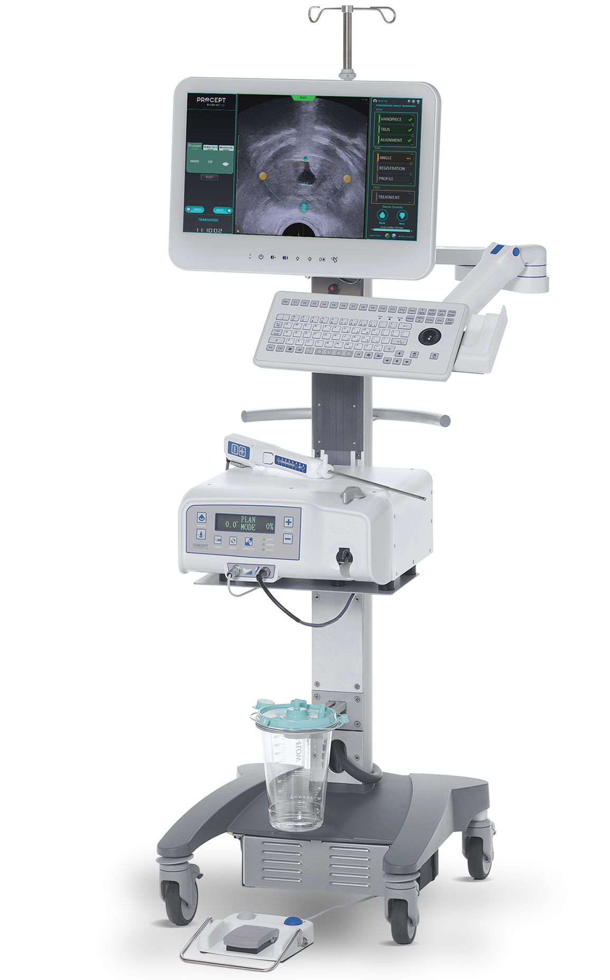
Elevating the Standard of Care for Benign Prostatic Hyperplasia (BPH) Treatment
Insert Hospital or Practice Logo

Slide 2
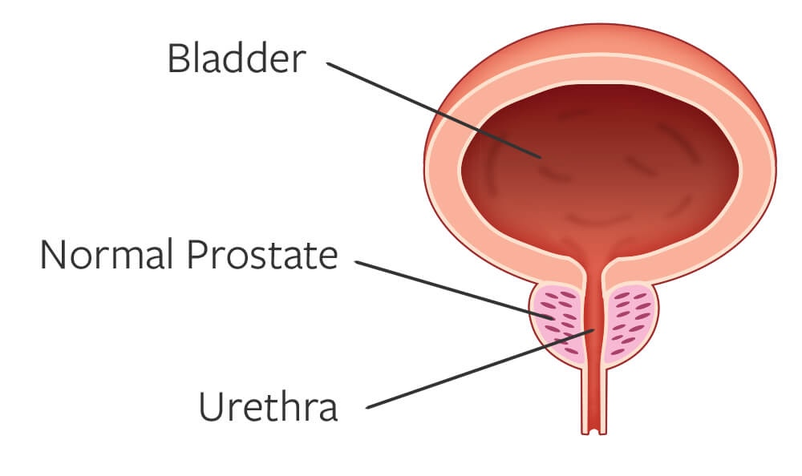
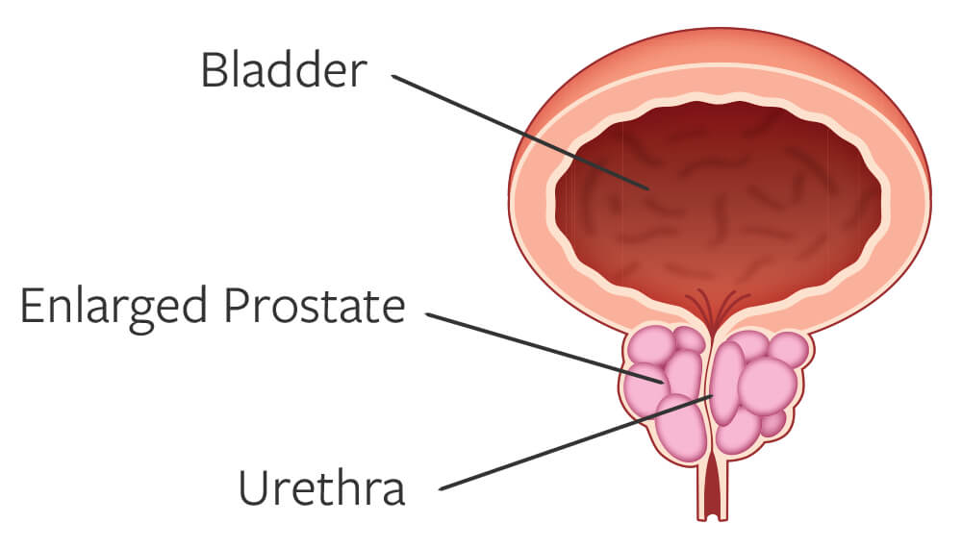
BPH is Prevalent and Expected to Increase
NORMAL PROSTATE
BPH is the #1 reason men visit the urologist
50% of men 51-60 years old have BPH
90% of men 80-90 years old suffer from BPH
ENLARGED PROSTATE (BPH)
~40M men in the US living with BPH in the US
Vuichoud C, Loughlin KR. Benign prostatic hyperplasia: epidemiology, economics and evaluation. Can J Urol. 2015;22(suppl1):1-6.
Notes:
https://www.ncbi.nlm.nih.gov/pmc/articles/PMC8170717/

Slide 3










Lower Urinary Tract Symptoms Due to BPH
1
2
99%
Men say BPH impacts their
quality of lifef²
ABILITY TO HOLD URINE
EMPTYING THE BLADDER
Nocturia: the need to urinate frequently while sleeping
Frequency: the need to urinate more often than normal
Urgency: the need to urinate immediately or urgently
Incontinence: complete loss of the ability to hold urine
Weak Stream: gentle instead of a strong stream of urine
Straining: the need to push to start or complete urinating
Hesitancy: difficulty starting to urinate
Intermittency: a urine stream that starts and stops
Retention: complete loss of the ability to empty the bladder
Disrupted Sleep, Limited Activities, Sexual Dysfunction
2. Data on file at PROCEPT BioRobotics.

Slide 4


Many Men Go Untreated Due to Unwanted Side Effects
40M
MEN
In the US have BPH
12M+ US MEN actively managed
for BPH each year
6.7M
PHARMACEUTICALS/MEDICATIONS
Suffer dosing adjustments and side effects
1.1M
PHARMACEUTICAL FALLOUT
Delay surgery despite medication failure
400K
SURGERIES PER YEAR
May compromise between safety and efficacy outcomes
83%
OF MEN ARE NOT WILLING TO SACRIFICE SEXUAL FUNCTION FOR SYMPTOM RELIEF²
Vuichoud C, Loughlin KR. Benign prostatic hyperplasia: epidemiology, economics and evaluation. Can J Urol. 2015;22(suppl1):1-6.
Emberton M, Marberger M, de la Rosette J. Understanding patient and physician perceptions of benign prostatic hyperplasia in Europe: the Prostate Research on Behaviour and Education (PROBE) Survey. Int J Clin Pract. 2008;62(1):18-26. 3.
Kaplan SA. Factors in predicting failure with medical therapy for BPH. Rev Urol. 2005; 7(suppl 7):S34-S39.
2. Data on file at PROCEPT BioRobotics.

Slide 5





Aquablation Minimizes the Compromise in All Prostates
UROLOGISTS CAN TREAT MORE PATIENTS WITH A SINGLE MODALITY
Unmet Need: Safety & Efficacy
in Prostates of All Sizes and Shapes
PRIORITIZE
Sexual Function
and Continence Preservation
PRIORITIZE
Symptom
Relief
Symptom Relief
Sexual Function
and Continence Preservation
small
(30-40mL)
medium
(40-80mL)
large
(80-150mL)
extra large
(150mL+)
TURP & PVP
Enucleation & Simple
NON-RESECTIVE
MIST
RESECTIVE
PVP = Photovaporization of Prostate
MIST: Minimally Invasive Surgical Technology
BPH size ranges: AUA Guidelines: Management of Lower Urinary Tract Symptoms Attributed to Benign Prostatic Hyperplasia (BPH): AUA Guideline Amendment 2023
Tanneru et al: An Indirect Comparison of Newer Minimally Invasive Treatments for Benign Prostatic Hyperplasia: A Network Meta-Analysis Model, Journal of Endourology, 2020
Notes:
TALK TO SNEHA - is this the correct slide from what Sneha was working on
Move image up so disclaimers are separated

Slide 6
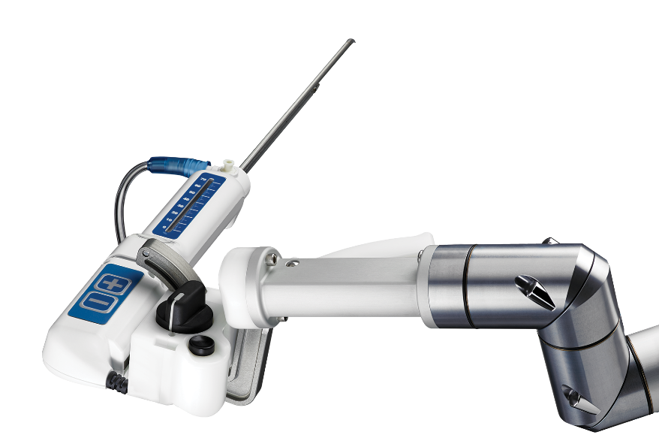
Aquablation Therapy is a Game-changing Robotic-assisted Procedure that Removes Prostate Tissue Using the Power of Water
Real-Time Image Guidance
Aquablation Therapy - the only ultrasound guided, robotic-assisted, heat-free waterjet for the treatment of BPH.
Real-time ultrasound imaging combined with cystoscopic view provide a multidimensional view of the prostate
Personalized Treatment Planning
Advanced planning software to map the treatment area & identify tissue to protect and obstructive tissue to resect
Robotic-ASSISTED Execution
Robotic-assisted execution of the waterjet along the treatment plan results in precise tissue resection
Heat-Free Waterjet Resection
Heat-free waterjet precisely removes prostate tissue and minimizes thermal damage to surrounding tissue

Slide 7




JOIN THE MOMENTUM
Aquablation therapy is backed by robust long-term clinical trial data…
5-year results
5-year results
1-year results
3-month results
Prostates 30 mL to 80 mL
Prostates 80 mL to 150 mL
Prostates 20 mL to 150 mL
Prostates 20 mL to 242 mL
Aquablation therapy has shown in clinical trials to deliver significant, durable symptom relief
while preserving sexual function & continence across prostates of all shapes and sizes¹⁻³
1. Gilling PJ, Barber N, Bidair M, et al. Five-year outcomes for Aquablation therapy compared to TURP: results from a double-blind, randomized trial in men with LUTS due to BPH. Can J Urol. 2022;29(1):10960-10968.
2. Bhojani N, Bidair M, Kramolowsky E, et al. Aquablation Therapy in Large Prostates (80-150 mL) for Lower Urinary Tract Symptoms Due to Benign Prostatic Hyperplasia: Final WATER II 5-Year Clinical Trial Results. J Urol. 2023;210(1):143-153.
3. PROCEPT data on file.

Slide 8

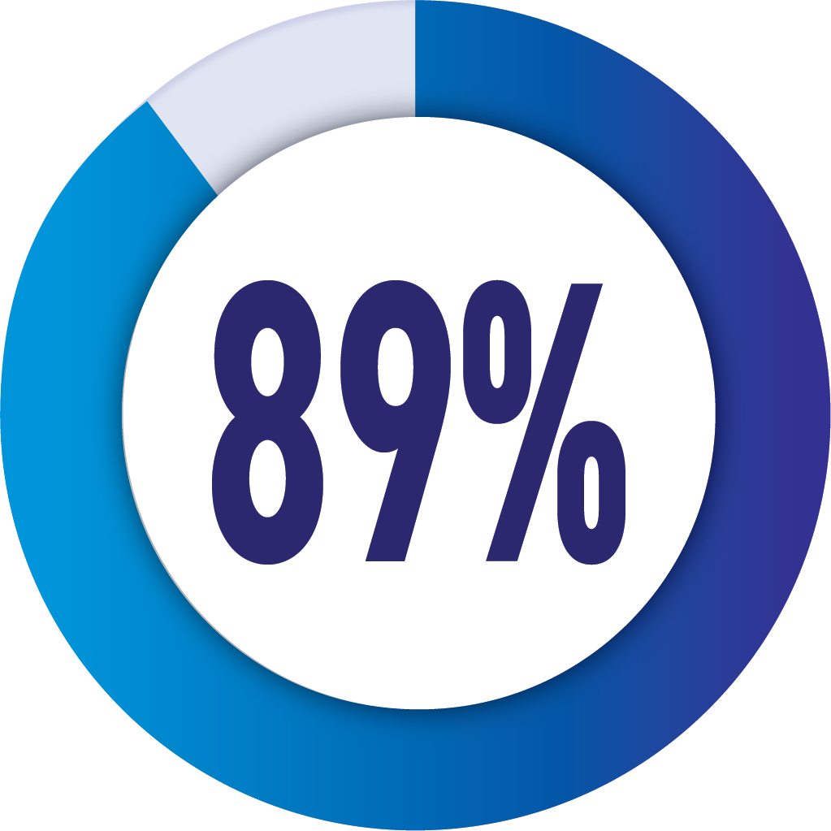
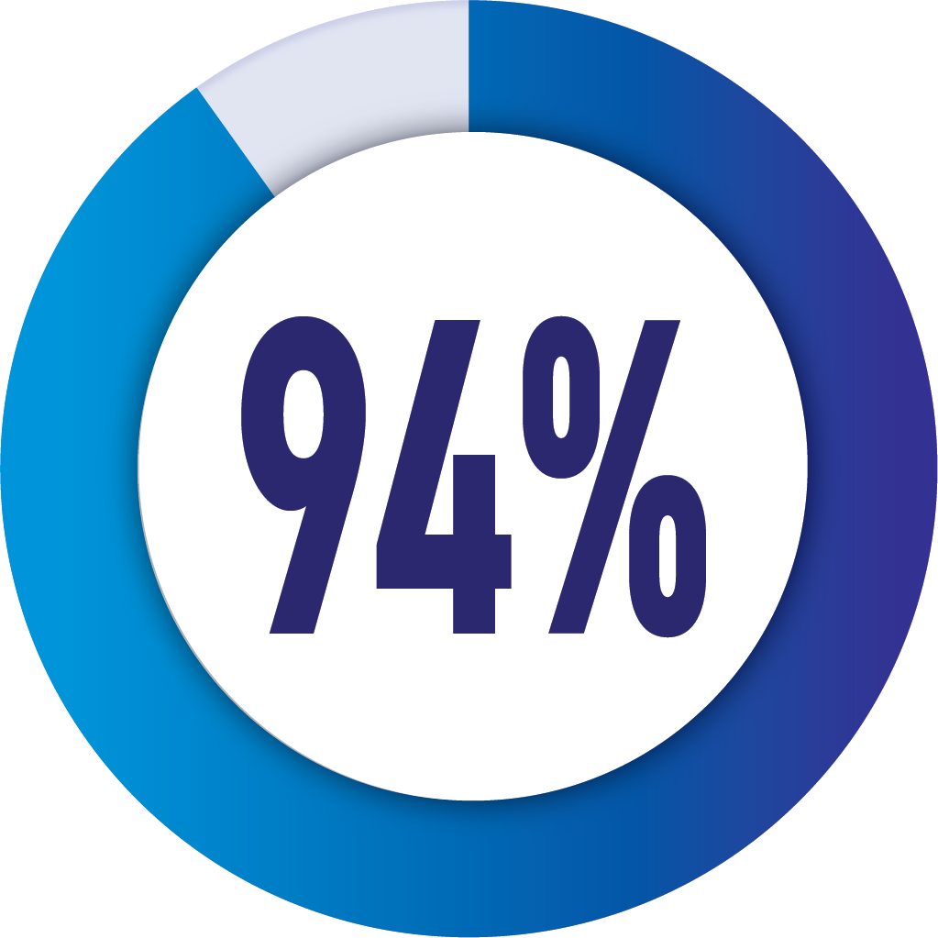
JOIN THE MOMENTUM
Aquablation therapy has shown in clinical trials to deliver significant, durable symptom relief
while preserving sexual function & continence across prostates of all shapes and sizes¹⁻²
SAFETY
EFFICACY
DURABILITY
Low irreversible complications preserving sexual function & continence³
Significant
symptom relief³
Low retreatment rates after 5 years in small, medium and large sized prostates¹⁻²
Of patients
preserved
ejaculatory function³
Effective in improving patient symptom scores from “Severe” to “Mild” as measured by IPSS³
of patients did not need another BPH intervention at 5 years
post-Aquablation therapy¹⁻²
IPSS = International Prostate Symptom Score
1. Gilling PJ, Barber N, Bidair M, et al. Five-year outcomes for Aquablation therapy compared to TURP: results from a double-blind, randomized trial in men with LUTS due to BPH. Can J Urol. 2022;29(1):10960-10968.
2. Bhojani N, Bidair M, Kramolowsky E, et al. Aquablation Therapy in Large Prostates (80-150 mL) for Lower Urinary Tract Symptoms Due to Benign Prostatic Hyperplasia: Final WATER II 5-Year Clinical Trial Results. J Urol. 2023;210(1):143-153.
3.E lterman D, Gilling P, Roehrborn C, et al. Meta-analysis with individual data of functional outcomes following Aquablation for lower urinary tract symptoms due to BPH in various prostate anatomies. BMJ Surg Interv Health Technologies 2021;3:e000090. doi:10.1136/bmjsit-2021-000090

Slide 9
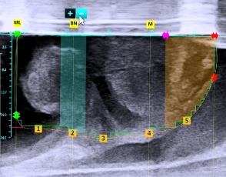
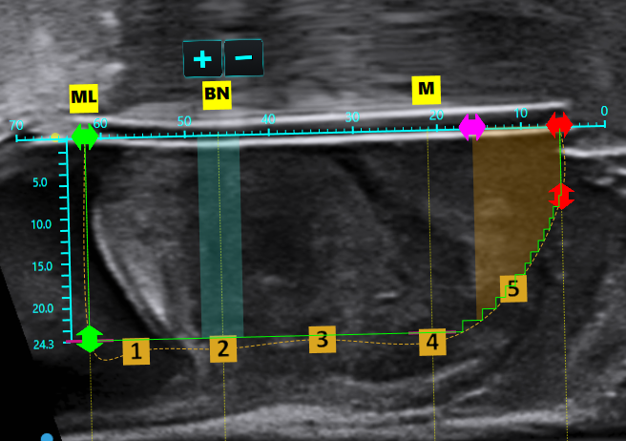
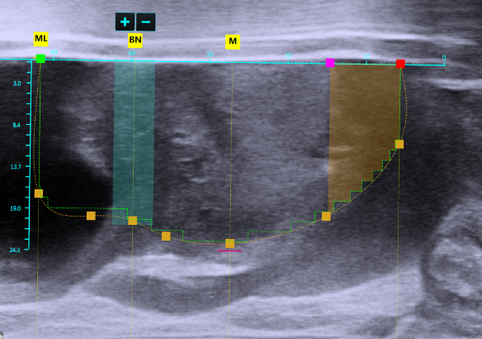
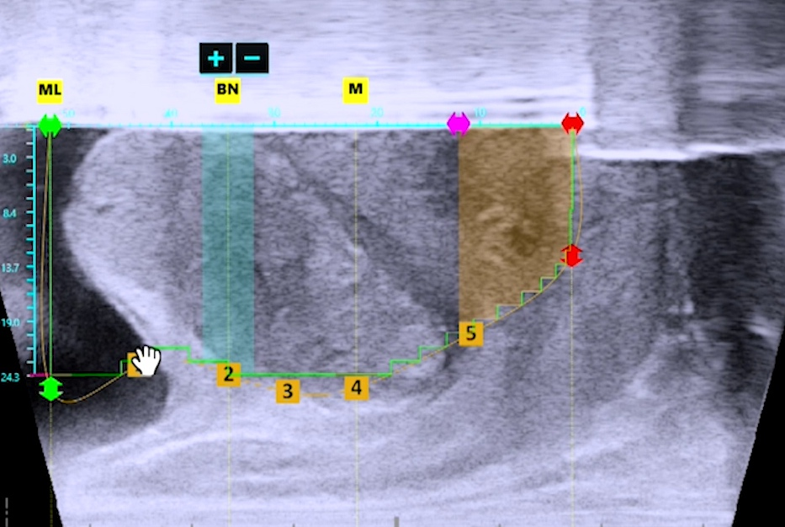
Personalized Treatment Planning
Identify critical anatomy
5
3
5
1
1
MEDIAN LOBE | RESECT
4
4
1
3
2
BLADDER NECK | PRESERVE
2
2
3
LATERAL LOBE | RESECT
4
VERUMONTANUM | PRESERVE
5
5
5
1
3
1
3
EXTERNAL SPHINCTER | PRESERVE
4
4
Create treatment CONTOUR
2
2

Slide 10
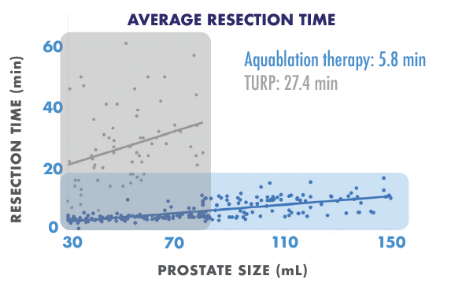
Predictable, Robotic-Execution Heat-Free Waterjet Resection
LESS VARIABILITY IN RESECTION TIMES
Surgeons participating in trial were experienced TURP surgeons with no Aquablation experience
ROBOTIC-EXECUTION
ENABLES CONSISTENT RESECTION TIMES
REGARDLESS OF PROSTATE SIZE & SURGEON EXPERIENCE
Data on file, PROCEPT BioRobotics
Notes:
Through robotic-automation, there is less variability in resection times, regardless of surgeon experience with Aquablation therapy

Slide 11
Aquablation Therapy Procedure Animation Video

Slide 12

What to Expect After Aquablation Therapy
As with most BPH procedures, patients will wake up with a catheter to allow the urethra to heal
Patients may be discharged the same day or stay overnight in the hospital
Patients may leave the hospital without a catheter¹⁻³
Patients may experience mild burning during urination for the first few weeks
Patients may resume normal activities once approved by their doctor
Your doctor will provide specific discharge instructions and advise on signs and symptoms that may require further medical attention
For safety information, visit https://bit.ly/3XA6SIi
Most symptoms typically resolve within two to four weeks after Aquablation therapy, though individual results may vary.³
1. Gilling et al. Five-year outcomes for Aquablation therapy compared to TURP: a randomized controlled trial in men with LUTS due to BPH Can J Urol 2022; 29(1):10960-10968.
2. Zorn KC, Bidair M, Trainer A,Arther A, Kramolowsky E, Desai M, et al. Aquablation therapyin large prostates (80–150 cc) for lower urinary tractsymptoms due to benign prostatic hyperplasia: WATER II 3-year trial results. BJUI Compass. 2022;3(2):130–138.
3. Data on File at PROCEPT BioRobotics

Slide 13
My Experience With Aquablation Therapy
For the doctor to input information
Patient Selection
Patient Recovery
Patient Satisfaction
Efficiency in the OR
Learning Curve
How it fits in my practice

Slide 14
Howards Journey with BPH – Patient Testimonial

Slide 15
[Recommend Inserting Slide About Practice]
Suggested topics to include on this slide
Practice logo
Contact info
Link to Aquablation therapy section on practice website
Details about Aquablation therapy experience to date (eg, # of cases)
For more information, visit Aquablation.com

Slide 16
Risk and Safety Information
All surgical treatments have inherent and associated side effects. Individual’s outcomes may depend on a number of factors, including but not limited to patient characteristics, disease characteristics and/or surgeon experience. The most common side effects are mild and transient and may include mild pain or difficulty when urinating, discomfort in the pelvis, blood in the urine, inability to empty the bladder or a frequent and/or urgent need to urinate, and bladder or urinary tract infection. Other risks include ejaculatory dysfunction and a low risk of injury to the urethra or rectum where the devices gain access to the body for treatment. Further, there may be other risks as in other urological surgery, such as anesthesia risk or the risk of infection, including the potential transmission of blood borne pathogens. For more information about potential side effects and risks associated with Aquablation® therapy for Benign Prostatic Hyperplasia (BPH) treatment, speak with your urologist or surgeon. Prior to using our products, please review the Instructions for Use, Operator’s Manual or User Manual, as applicable, and any accompanying documentation for a complete listing of indications, contraindications, warnings, precautions and potential adverse events. No claim is made that the HYDROSTM Robotic System or the AquaBeam® Robotic System will cure any medical condition, or entirely eliminate the diseased entity. Repeated treatment or alternative therapies may sometimes be required.
As with any surgical urologic procedure, potential perioperative risks of the Aquablation procedure include but are not limited to the following, some of which may lead to serious outcomes and may require intervention: Anesthesia risk, Bladder or prostate capsule perforation, Bladder neck contracture, Bleeding or blood in the urine, Bruising, Penile or pelvic pain, Irritative symptoms, which may include dysuria, urgency or frequency, Infection, Transurethral resection (TUR) syndrome, Electric shock/burn, Urethral damage causing false passage or stricture, Rectal incontinence/perforation, Sexual dysfunction, including ejaculatory and erectile dysfunction, Incontinence or overactive bladder, Embolism, Urinary Retention.
Rx Only
Please review the Instructions for Use and any accompanying documentation for a complete listing of indications, contraindications, warnings, precautions, and potential adverse events.
© 2024 PROCEPT BioRobotics Corporation. All rights reserved. AQUABLATION, AquaBeam, PROCEPT BioRobotics, and the PROCEPT BioRobotics logo are registered trademarks of PROCEPT BioRobotics Corporation. ML0624.A

