Slide 1
Aquablation Therapy:
For the Man Who Is Tired of BPH
[INSERT Doctors name and practice/hospital here]

Slide 2
Physician Name – Practice/hospital
Inset headshot here
Undergraduate
XXX University
Major
Inset practice/hospital logo here
Medical School
XXX
School of Medicine
Residency
Urology
XXX Medical Center

Slide 3
Disclosures
Disclosures here (if applicable)
The views expressed in this presentation are those of the presenter and do not necessarily reflect the views or policies of PROCEPT BioRobotics or its subsidiaries. No official endorsement by PROCEPT BioRobotics or any of its subsidiaries of any vendor, products or services contained in this presentation is intended or should be inferred.

Slide 4
Today’s Presentation: Key Questions We’ll Address
1
What is Benign Prostatic Hyperplasia (BPH)?
What are my treatment options?
Why should I consider Aquablation® Therapy?
Hear from real patient experiences.
2
3
4

Slide 5
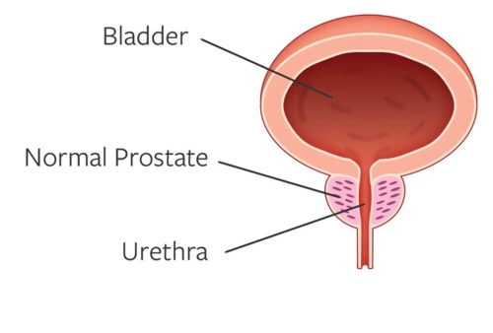
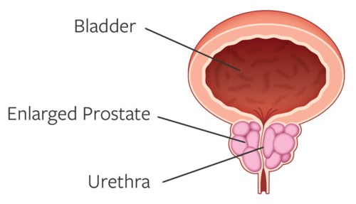
Understanding BPH
1 in 2
men ages 51-60 have BPH & rates ↑ EVERY DECADE¹
What is a Prostate?
NORMAL PROSTATE
The prostate is a gland that plays an important role in male sexual function. During a man’s life, the prostate will grow slowly.
What is Benign Prostatic Hyperplasia (BPH)
ENLARGED PROSTATE
BPH is a prostate that has grown to be larger than normal. The prostate continues to grow due to testosterone, as it continues to grow it can cause lower urinary tract symptoms.
BPH is NOT prostate cancer.

Slide 6
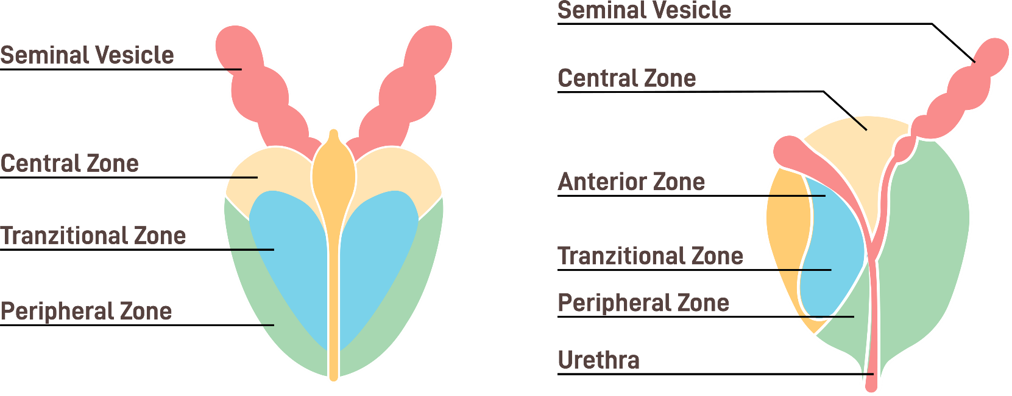
BPH is Enlargement of the Transition Zone in the Prostate
Transition zone enlargement obstructs flow of urine from the bladder
BPH is an anatomical disease that requires an anatomical treatment
Goal is to treat the obstruction but maintain function of the prostate

Slide 7


Many Men Go Untreated Due to Unwanted Side Effects
40M
MEN
In the US have BPH
12M+ US MEN actively managed
for BPH each year
6.7M
PHARMACEUTICALS/MEDICATIONS
Suffer dosing adjustments and side effects
1.1M
PHARMACEUTICAL FALLOUT
Delay surgery despite medication failure
400K
SURGERIES PER YEAR
May compromise between safety and efficacy outcomes
83%
OF MEN ARE NOT WILLING TO SACRIFICE SEXUAL FUNCTION FOR SYMPTOM RELIEF²
Vuichoud C, Loughlin KR. Benign prostatic hyperplasia: epidemiology, economics and evaluation. Can J Urol. 2015;22(suppl1):1-6.
Emberton M, Marberger M, de la Rosette J. Understanding patient and physician perceptions of benign prostatic hyperplasia in Europe: the Prostate Research on Behaviour and Education (PROBE) Survey. Int J Clin Pract. 2008;62(1):18-26. 3.
Kaplan SA. Factors in predicting failure with medical therapy for BPH. Rev Urol. 2005; 7(suppl 7):S34-S39.

Slide 8










Lower Urinary Tract Symptoms Due to BPH
1
2
99%
Men say BPH impacts their
quality of lifef²
ABILITY TO HOLD URINE
EMPTYING THE BLADDER
Nocturia: the need to urinate frequently while sleeping
Frequency: the need to urinate more often than normal
Urgency: the need to urinate immediately or urgently
Incontinence: complete loss of the ability to hold urine
Weak Stream: gentle instead of a strong stream of urine
Straining: the need to push to start or complete urinating
Hesitancy: difficulty starting to urinate
Intermittency: a urine stream that starts and stops
Retention: complete loss of the ability to empty the bladder
Disrupted Sleep, Limited Activities, Sexual Dysfunction

Slide 9
Diagnosing BPH & IPSS Evaluation - Know your Score!
Your urologist may evaluate:
Physical exam of your prostate
Review of your symptoms
Medical tests to evaluate bladder function and prostate anatomy
If you were to spend the rest of your life with your urinary condition just the way it is now, how would you feel about that?
International Prostate Symptom Score (IPSS)
During the last month, how many times did you get up at night to urinate?
0 to 7 points | Mild Symptoms
8 to 19 points | Moderate Symptoms
20 to 35 points | Severe Symptoms
Visit: Aquablation.com to take the IPSS evaluation & download your results

Slide 10
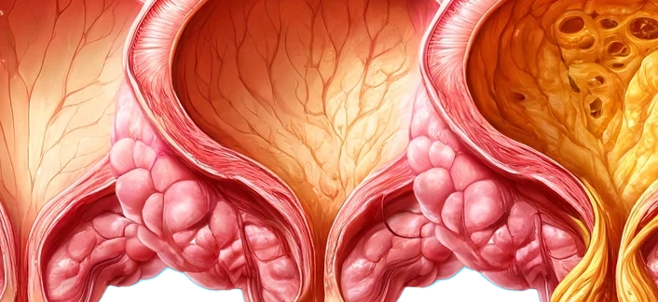
BPH is a Chronic Disease with Long Term Consequences if NOT treated
Bladder damage
Bladder catheterization
Bladder stones
Blood in urine
Urinary tract infections
Kidney failure
Healthy
Bladder
Moderate Bladder
Damage
Permanent Bladder
Damage
Watchful waiting can lead to permanent bladder damage

Slide 11

Treatment Options – Every Patient is Unique
Watchful Waiting
Medications
Minimally Invasive
Surgical Technique
Traditional Surgery
Mild-to-Moderate Symptoms
Mild-to-Moderate Symptoms
Moderate-to-Severe Symptoms
Moderate-to-Severe Symptoms
No symptom relief
As the prostate continues to grow symptoms worsen with time
May cause irreversible bladder damage
Minimal symptom relief
Common side effects may include dizziness, headache, fatigue, less libido, erectile & ejaculatory dysfunction³
Over time, drugs may stop working
Moderate symptom relief
Typically, same day procedure, may be performed in office
May not last⁴ & may require retreatment
Size & shape limitations
Significant long-term symptom relief^{5,6}
Typically, requires overnight hospital stay
High rates of irreversible complications - sexual dysfunction & incontinence⁵⁻¹²

Slide 12
BPH Treatments Trade-off Effectiveness and Sexual Side Effects
76%
Men feel BPH surgery requires a tradeoff between safety & efficacy²
PRIORITIZE
SEXUAL
FUNCTION & CONTINENCE
PRESERVATION
PRIORITIZE
SYMPTOM
RELIEF
Traditional
Surgery
83%
Men are not willing to sacrifice sexual function for symptom relief²
MIST
SEXUAL
FUNCTION & CONTINENCE
PRESERVATION
SYMPTOM
RELIEF
99%
Men say BPH impacts their quality of life²

Slide 13
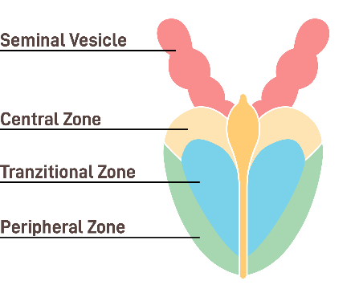

Aquablation Therapy – Minimizes BPH Treatment Trade-offs
Aquablation therapy is the only BPH treatment clinically proven to provide long-term symptom relief while preserving sexual function and continence in prostates of all shapes and sizes.¹¹⁻¹³
Aquablation Therapy vs. TURP
Significant Symptom Improvement^{11,12}
2x improvement in flow of urine
Best in class 16-point IPSS improvement
Aquablation Therapy | TURP
Novel technique, >50K patients treated | 100-year-old technique
Lower rates of irreversible complications* | Higher rates of irreversible complications*
Multiple views of the prostate with real-time ultrasound | Limited view of the prostate
Uses waterjet to remove prostate tissue | Uses heat to remove prostate tissue
Robotic-assisted | Fully surgeon dependent
Low Retreatment Rates^{11,12}
after 5-years
Superior Safety Compared to TURP¹²
*Irreversible complications - incontinence, erectile & ejaculatory dysfunction^{1,2}

Slide 14
Aquablation Therapy Proven Safe & Effective in Clinical Studies^{1,2}
>99%
89%
>99%
94%
Of men preserved erectile & orgasmic function, sexual desire, intercourse satisfaction or overall sexual satisfaction
Of men preserved ejaculatory function with Aquablation therapy
Of men did not have incontinence after Aquablation therapy
Of men did not require additional treatment with medications or surgery 5-years after Aquablation therapy

Slide 15
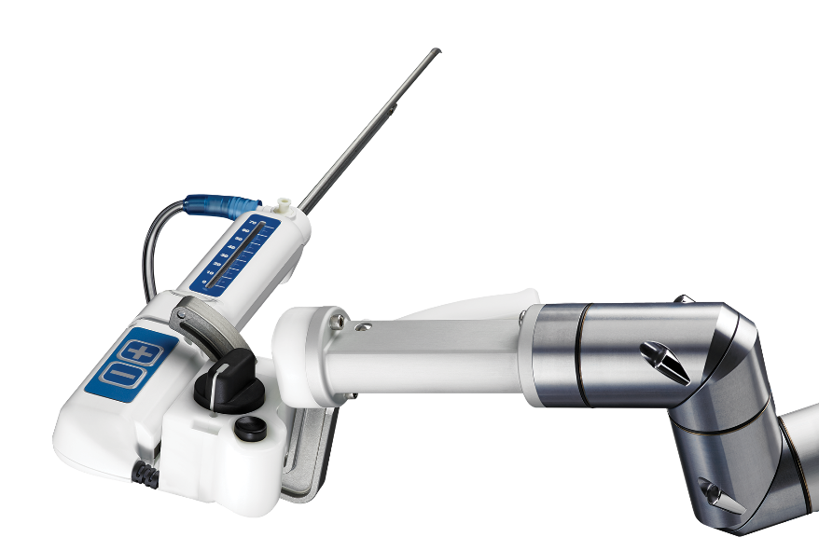
Aquablation Therapy is a Game-changing Robotic-assisted Procedure That Removes Prostate Tissue Using the Power of Water
Real-Time Image Guidance
Aquablation Therapy - the only ultrasound guided, robotic-assisted, heat-free waterjet for the treatment of BPH.
Real-time ultrasound imaging combined with cystoscopic view provide a multidimensional view of the prostate
Personalized Treatment Planning
Advanced planning software to map the treatment area & identify tissue to protect and obstructive tissue to resect
Robotic-ASSISTED Execution
Robotic-assisted execution of the waterjet along the treatment plan results in precise tissue resection
Heat-Free Waterjet Resection
Heat-free waterjet precisely removes prostate tissue and minimizes thermal damage to surrounding tissue

Slide 16
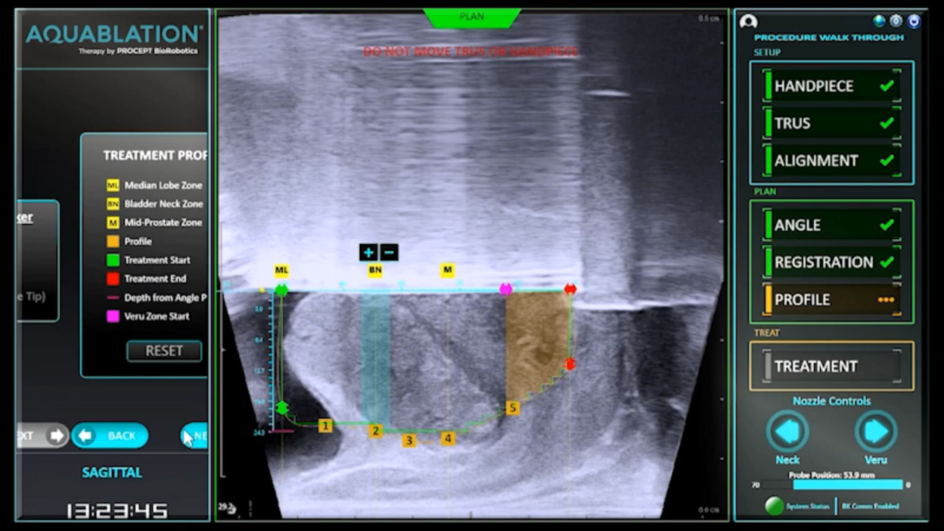
Aquablation Therapy – How it Works Part 1
1
REAL-TIME SURGICAL PLANNING
With the help of ultrasound guidance, watch how surgeons create a detailed treatment plan for which tissue to protect and which tissue to resect.
Protect the areas responsible for sexual function and continence.
Resect obstructive prostate tissue.

Slide 17
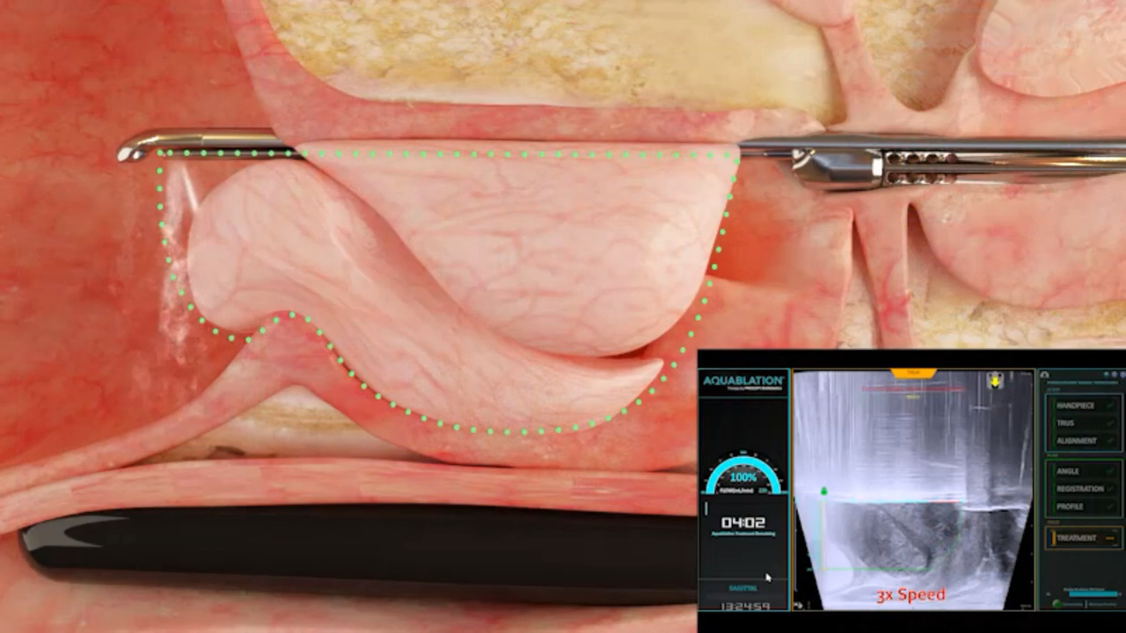
Aquablation Therapy – How it Works Part 2
2
REMOVE OBSTRUCTING PROSTATE TISSUE
Next, a robotic-assisted heat-free waterjet follows the treatment plan to precisely resect obstructive prostate tissue and protect the areas responsible for sexual function and continence.
This advanced technology helps ensure precise, consistent and predictable removal of prostate tissue.

Slide 18

What to Expect After Aquablation Therapy
As with most BPH procedures, you will wake up with a catheter to allow the urethra to heal
Patients may be discharged the same day or stay overnight in the hospital
Patients may leave the hospital without a catheter^{15,16}
Patients may experience mild burning during urination for the first few weeks
Patients may resume normal activities once approved by their doctor
Your doctor will provide specific discharge instructions and advise on signs and symptoms that may require further medical attention
Most symptoms typically resolve within two to four weeks after Aquablation therapy, though individual results may vary.²

Slide 19


Journey with BPH: Take the Next Step to Long-term Symptom Relief
Watchful Waiting
Medications
MIST
Traditional Prostate Surgery
Aquablation
Therapy

Slide 20
Insert Local Patient Story Here or DELETE this slide

Slide 21
Howards Journey with BPH – Patient Testimonial

Slide 22
Safety Information
Aquablation therapy is performed by urologists. Patients should talk to their doctor to determine if Aquablation therapy is right for them. Patients and doctors should review the potential benefits and limitations of treatment together.
Risk and Safety Information
All surgical treatments have inherent and associated side effects, some of which may lead to serious outcomes and may require intervention. Individual’s outcomes may depend on a number of factors, including but not limited to patient characteristics, disease characteristics and/or surgeon behavior. The most common side effects are mild and transient and may include mild pain or difficulty when urinating, discomfort in the pelvis or penis, blood in the urine, inability to empty the bladder or a frequent and/or urgent need to urinate, and bladder or urinary tract infection. Other risks include but are not limited to: anesthesia risk; sexual dysfunction, including ejaculatory or erectile dysfunction; injury to the urethra, such as false passage or stricture, or to the rectum, including rectal incontinence / perforation; bladder or prostate capsule perforation; infection, including the potential transmission of blood borne pathogens; bleeding; incontinence; embolism; electric shock/burn; transurethral resection (TUR) syndrome; bladder neck contracture; and bruising. No claim is made that the AquaBeam Robotic System will cure any medical condition, or entirely eliminate the diseased entity. Repeated treatment or alternative therapies may sometimes be required.
For more information about potential side effects and risks associated with Aquablation therapy, speak with your urologist or surgeon.
Rx Only

Slide 23
References
Roehrborn, CG, Rosen, RC. Medical therapy options for aging men with benign prostatic hyperplasia: focus on alfuzosin 10 mg once daily. Clinical Interventions in Aging 2008:3(3).
Data on file at PROCEPT BioRobotics.
Kaplan, SA. Factors in Predicting Failure with Medical Therapy for BPH. Rev Urol. 2005;7 Suppl 7:S34-9.
Urology Care Foundation, The Official Foundation of the American Urological Association. Accessed Dec 2019. https://www.urologyhealth.org/urologic-conditions/benign-prostatic-hyperplasia-(bph)
Bachmann, A, et al. 180-W XPS GreenLight laser vaporisation versus transurethral resection of the prostate for the treatment of benign prostatic obstruction: 6-month safety and efficacy results of a European Multicentre Randomised Trial–the GOLIATH study. Eur Urol. 2014 May;65(5):931-42.
Sapetti, J, et al. Urinary incontinence after HOLEP: Incidence, evolution and predictive factors. Prog Urol. 2019 Feb;29(2):101-107.
Delay, KJ, et al. Ejaculatory dysfunction in the treatment of lower urinary tract symptoms. Transl Androl Urol. 2016 Aug; 5(4): 450–459.
Leong, JY. Minimizing Sexual Dysfunction in BPH Surgery. Curr Sex Health Rep. 2019 Sep; 11(3): 190–200.
Michalak, J, et al. HoLEP: the gold standard for the surgical management of BPH in the 21st century. Am J Clin Exp Urol. 2015; 3(1): 36-42.
Khera, M. Simple Prostatectomy. Medscape. 2018. https://emedicine.medscape.com/article/445996-print.
Gilling et al. Five-year outcomes for Aquablation therapy compared to TURP: a randomized controlled trial in men with LUTS due to BPH Can J Urol 2022; 29(1):10960-10968.
Bhojani et al. Aquablation therapy in large prostates (80-150 mL) for lower urinary tract symptoms due to benign prostatic hyperplasia: final WATER II 5-Year clinical trial results. 2023 Journal of Urology.
Elterman D et al. Meta-analysis with individual data of functional outcomes following Aquablation for lower urinary tract symptoms due to BPH in various prostate anatomies. BMJ Surg Interv Health Technologies. 2021Jun.

